Slide 1

A Fast Algorithm for Structured Low-Rank Matrix Recovery with Applications to Undersampled MRI Reconstruction
Greg Ongie*, Mathews Jacob
Computational Biomedical Imaging Group (CBIG)
University of Iowa, Iowa City, Iowa.
April 14, 2016
ISBI 2016, Prague

Slide 2
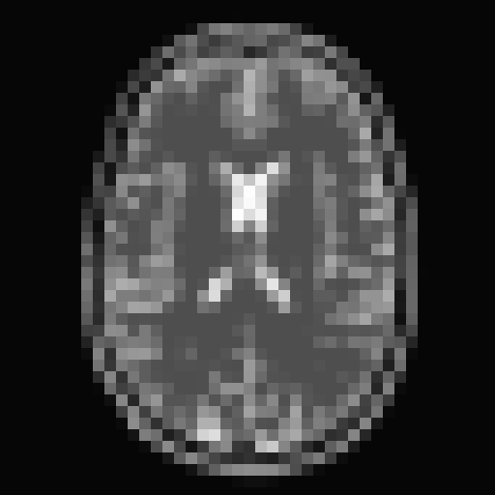
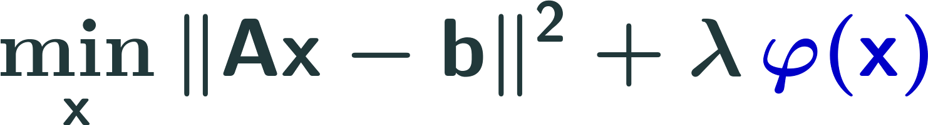


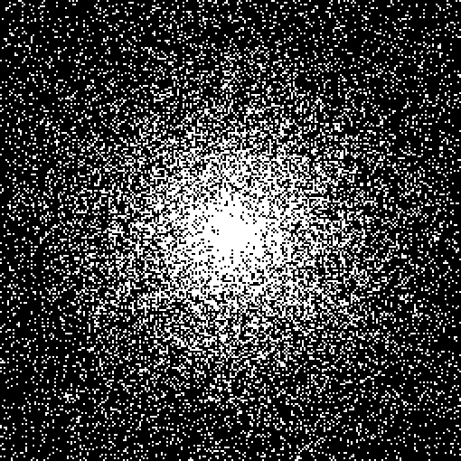
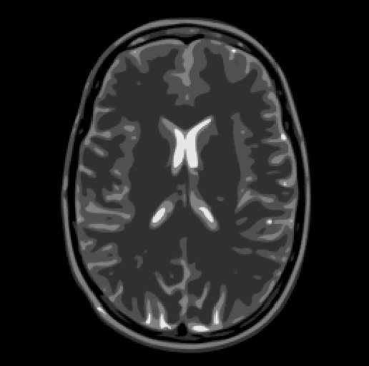

Compressed Sensing MRI Reconstruction
recovery posed in discrete image domain
smoothness/sparsity regularization penalty
Example: TV-minimization
25% k-space
Rel. Error = 5%

Slide 3
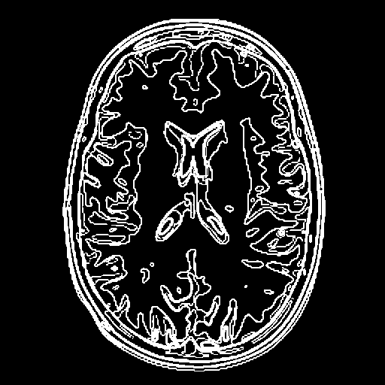
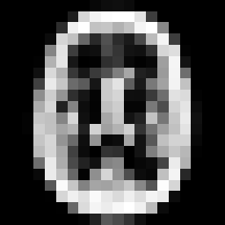
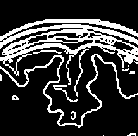
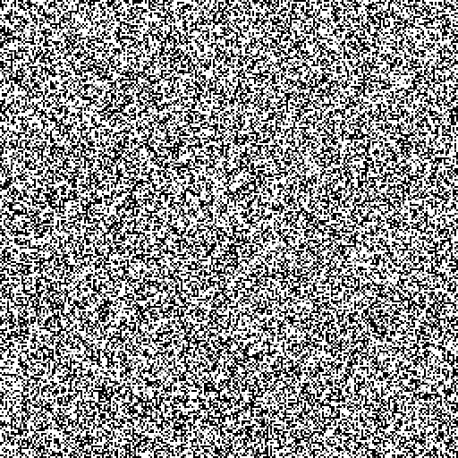

Drawbacks to TV Minimization
Discretization effects:
Lose sparsity when discretizing to grid
Unable to exploit structured sparsity:
Images have smooth, connected edges
Sensitive to k-space sampling pattern [Krahmer & Ward, 2014]

Slide 4
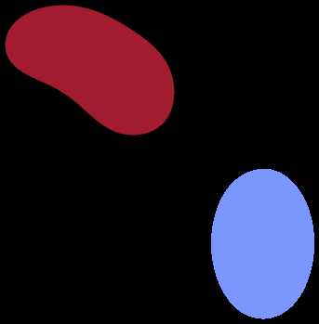
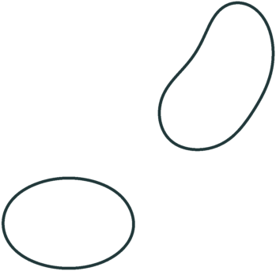
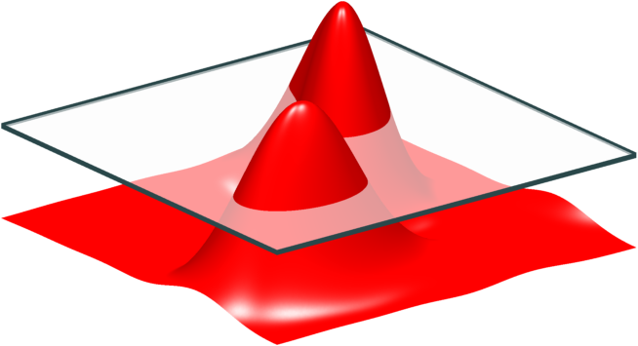
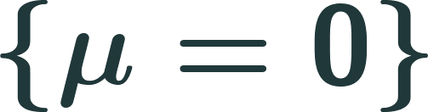
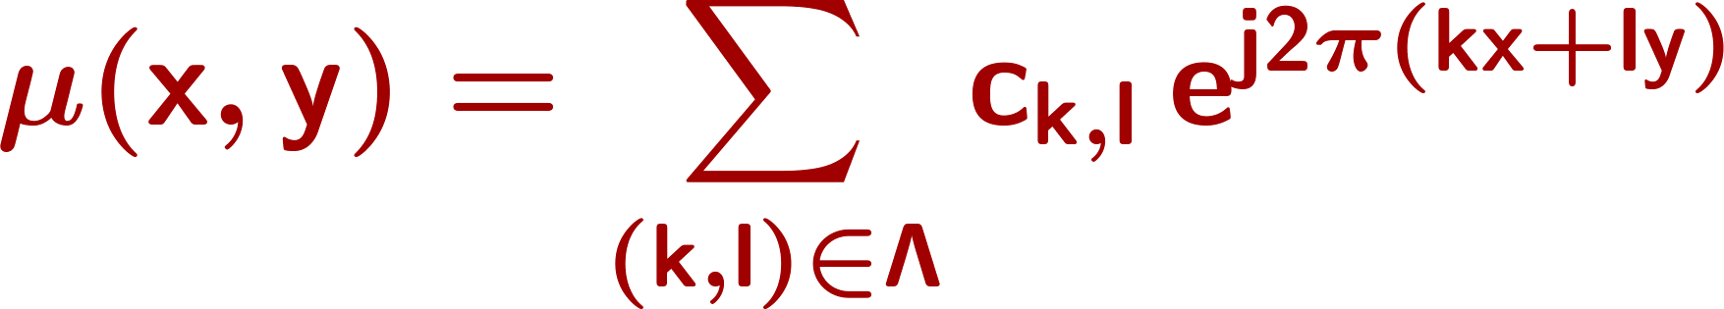
Off-the-Grid alternative to TV [O. & Jacob, ISBI 2015], [O. & Jacob, SampTA 2015]
Continuous domain piecewise constant image model
Model edge set as zero-set of a 2-D band-limited function
image
edge set
“Finite-rate-of-innovation curve” [Pan et al., IEEE TIP 2014]

Slide 5



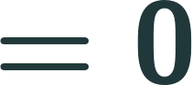
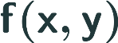

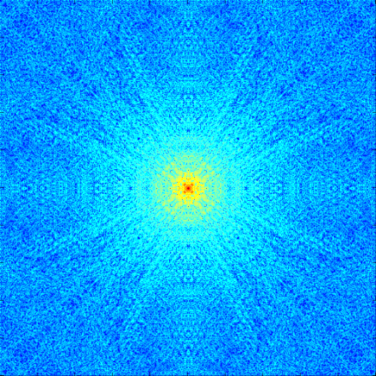
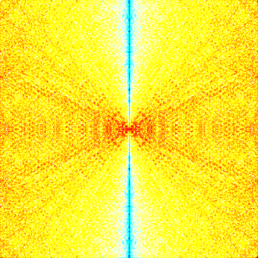
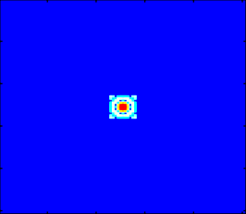
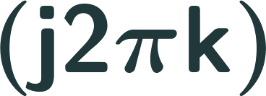

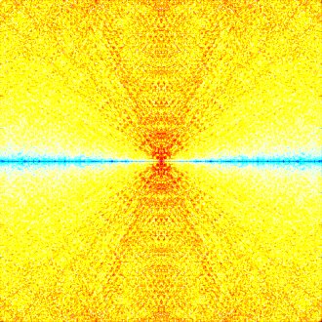

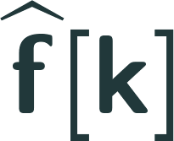
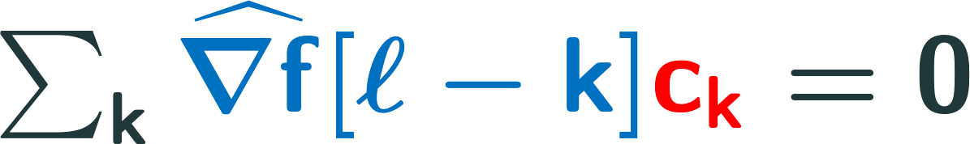
2-D PWC functions satisfy an annihilation relation
spatial domain
multiplication
Fourier domain
convolution
annihilating filter
Annihilation relation:

Slide 6
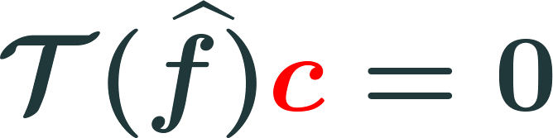


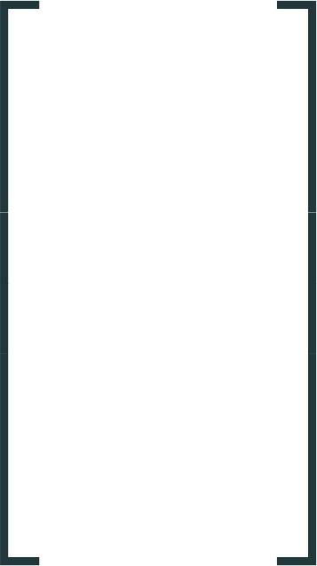
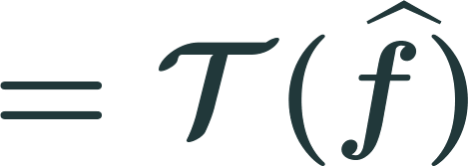

Matrix representation of annihilation
2-D convolution matrix
built from k-space samples
vector of filter coefficients
apply weights
Cartesian
k-space samples
2(#shifts) x (filter size)

Slide 7
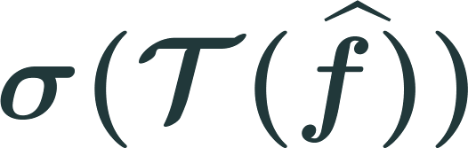
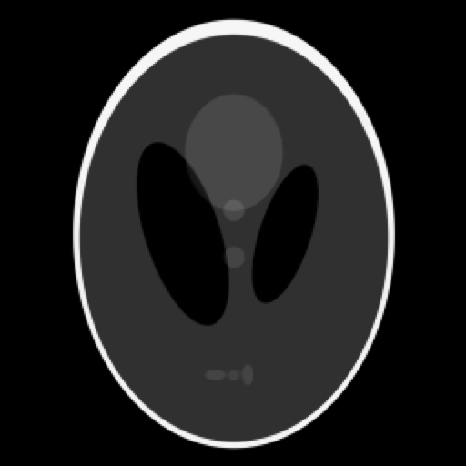
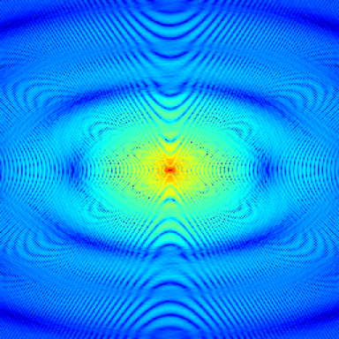
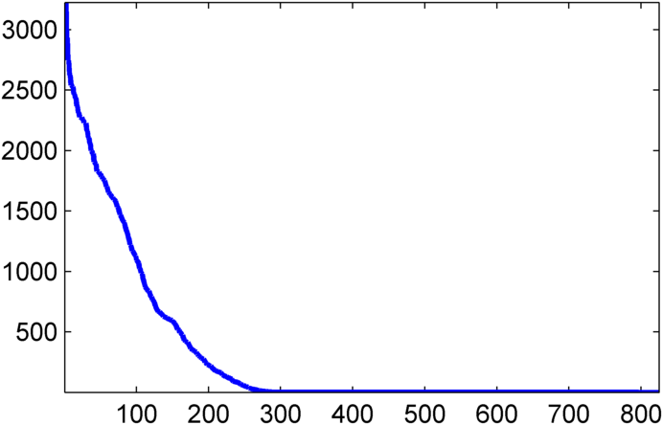

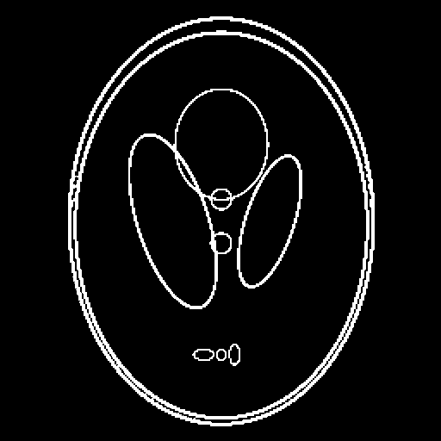
Matrix representation of annihilation
Basis of algorithms: Annihilation matrix is low-rank
Ex: Shepp-Logan
k-space
rank 300
Filter size: 33x25

Slide 8

Pose recovery from missing k-space data as structured low-rank matrix completion problem

Slide 9
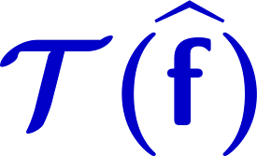

Pose recovery from missing k-space data as structured low-rank matrix completion problem
Toeplitz
1-D Example:
Missing data
Lift

Slide 10
Pose recovery from missing k-space data as structured low-rank matrix completion problem
Toeplitz
1-D Example:
Complete matrix
By minimizing rank

Slide 11
Pose recovery from missing k-space data as structured low-rank matrix completion problem
Toeplitz
1-D Example:
Complete matrix
By minimizing rank
Project

Slide 12
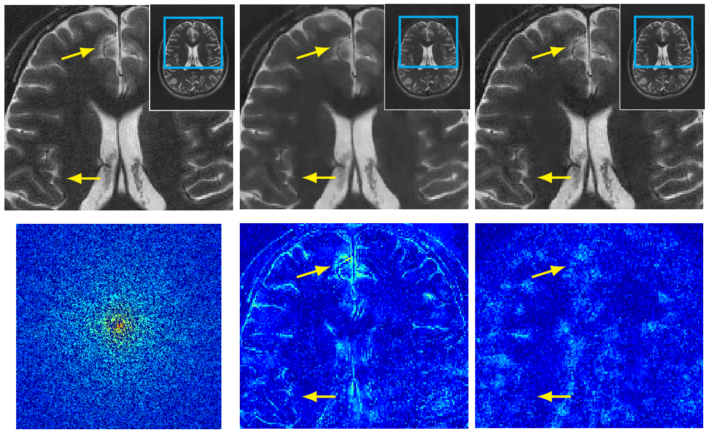
Fully sampled TV (SNR=17.8dB) Proposed (SNR=19.0dB)
50% k-space samples
(random uniform) error error
(Retrospective undersampled 4-coil data compressed to single virtual coil)

Slide 13
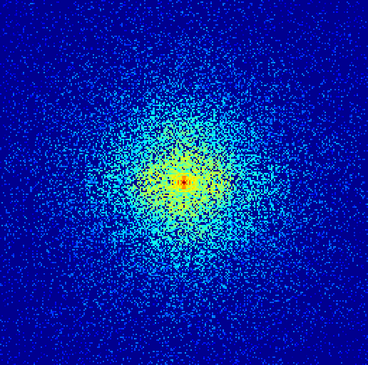
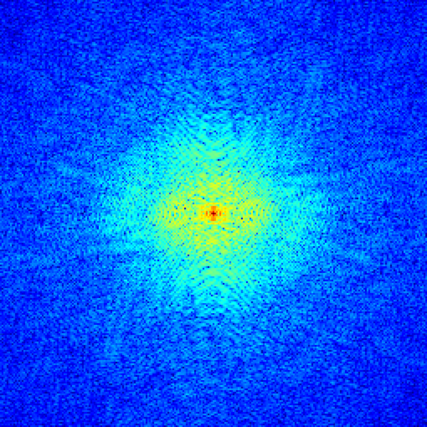
Emerging Trend: Fourier domain low-rank priors for MRI reconstruction
SAKE [Shin et al., MRM 2014]
Image model: Smooth coil sensitivity maps (parallel imaging)
LORAKS [Haldar, TMI 2014]
Image model: Support limited & smooth phase
ALOHA [Jin et al., ISBI 2015]
Image model: Transform sparse/Finite-rate-of-innovation
Off-the-grid models [O. & Jacob, ISBI 2015], [O. & Jacob, SampTA 2015]
Structured Low-rank
Matrix
Recovery
undersampled k-space
recovered k-space

Slide 14

Main challenge: Computational complexity
2-D
3-D
Image: 256x256 Filter: 32x32
256x256x32
32x32x10
~10⁶ x 1000
~10⁸ x 10⁵ ^{Cannot Hold} ^{in Memory!}

Slide 15
Outline
Prior Art
Proposed Algorithm
Applications

Slide 16
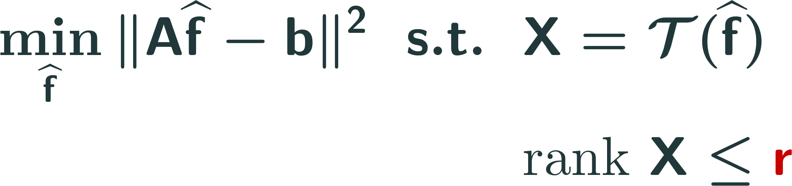
Cadzow methods/Alternating projections [“SAKE,” Shin et al., 2014], [“LORAKS,” Haldar, 2014]
No convex relaxations. Use rank estimate.

Slide 17
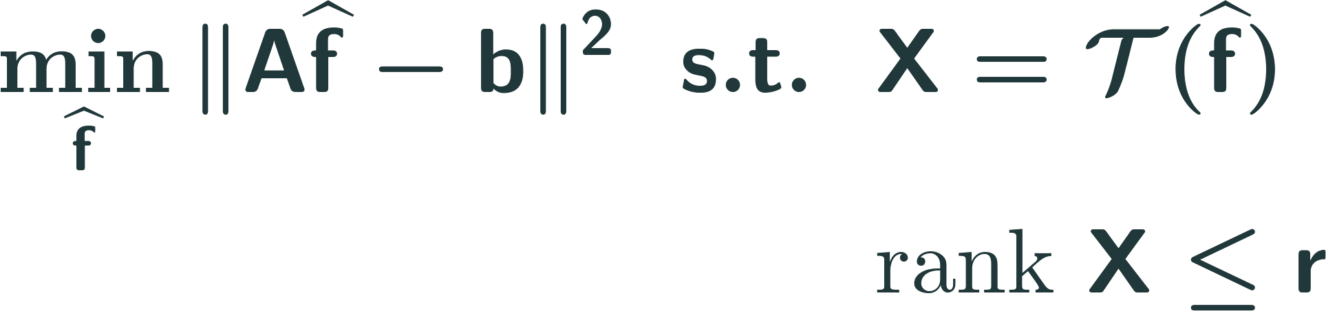
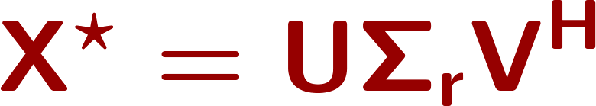
Cadzow methods/Alternating projections [“SAKE,” Shin et al., 2014], [“LORAKS,” Haldar, 2014]
Alternating projection algorithm (Cadzow)
Project onto space of rank r matrices -Compute truncated SVD:
Project onto space of structured matrices
-Average along “diagonals”

Slide 18
Cadzow methods/Alternating projections [“SAKE,” Shin et al., 2014], [“LORAKS,” Haldar, 2014]
Drawbacks
Highly non-convex
Need estimate of rank bound r
Complexity grows with r
Naïve approach needs to store large matrix

Slide 19
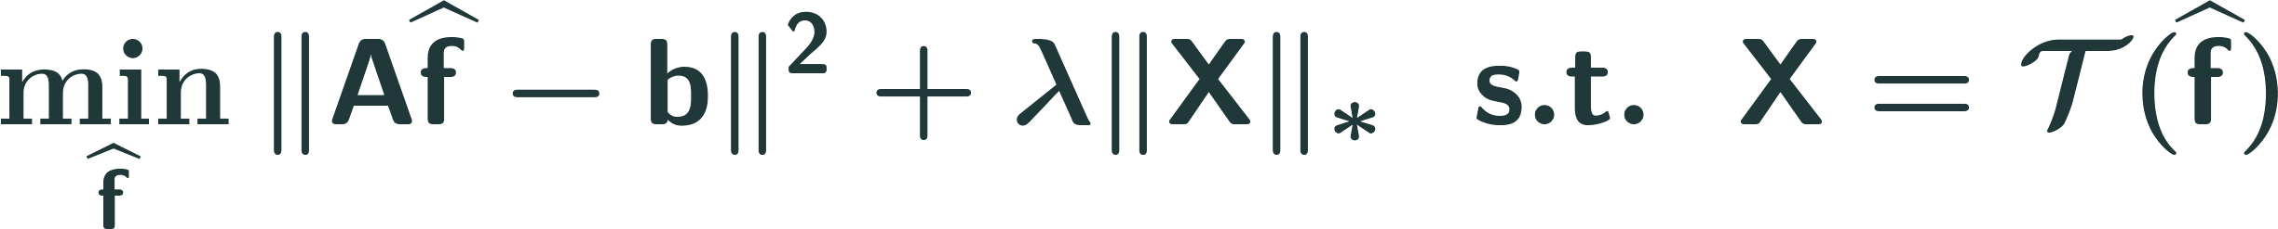
Nuclear norm minimization
ADMM = Singular value thresholding (SVT)
Singular value thresholding step -compute full SVD of X!
Solve linear least squares problem -analytic solution or CG solve

Slide 20
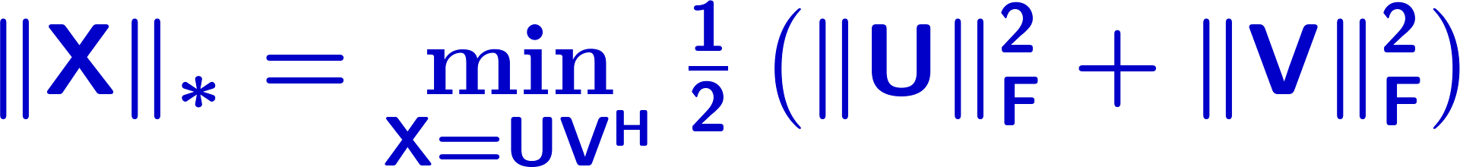





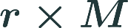


Nuclear norm minimization
“U,V factorization trick”
Low-rank factors

Slide 21
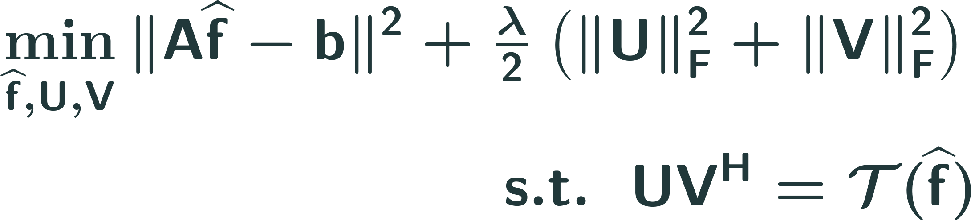
Nuclear norm minimization with U,V factorization [O.& Jacob, SampTA 2015], [“ALOHA”, Jin et al., ISBI 2015]
UV factorization approach
Singular value thresholding step -compute full SVD of X! SVD-free → fast matrix inversion steps
Solve linear least squares problem -analytic solution or CG solve

Slide 22
Nuclear norm minimization with U,V factorization [O.& Jacob, SampTA 2015], [“ALOHA”, Jin et al., ISBI 2015]
Drawbacks
Big memory footprint—not feasible for 3-D
U,V trick is non-convex

Slide 23

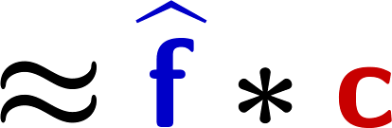
None of current approaches exploit structure of matrix liftings (e.g. Hankel/Toeplitz)
Can we exploit this structure to give a more efficient algorithm?

Slide 24
Outline
Prior Art
Proposed Algorithm
Applications

Slide 25
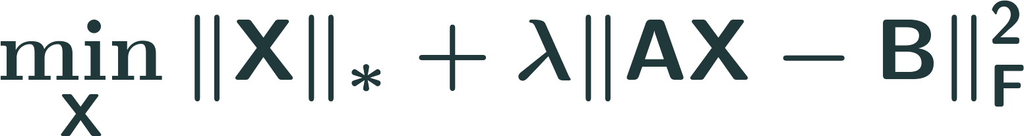
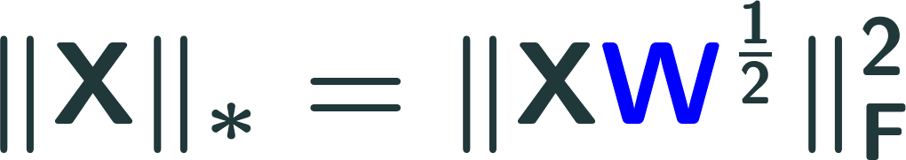
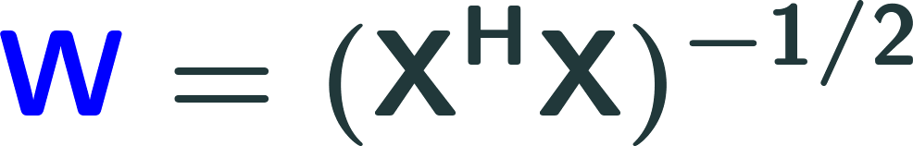
Proposed Approach: Adapt IRLS algorithm for nuclear norm minimization
IRLS: Iterative Reweighted Least Squares
Proposed for low-rank matrix completion in [Fornasier, Rauhut, & Ward, 2011], [Mohan & Fazel, 2012]
Solves:
Idea:
Alternate

Slide 26
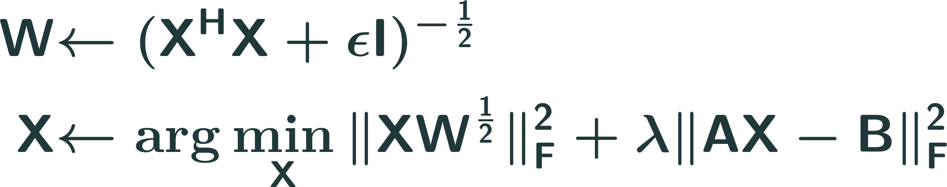
Original IRLS: To recover low-rank matrix X, iterate

Slide 27
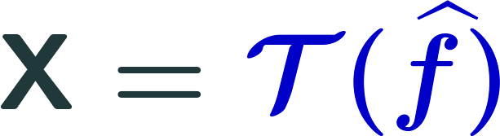
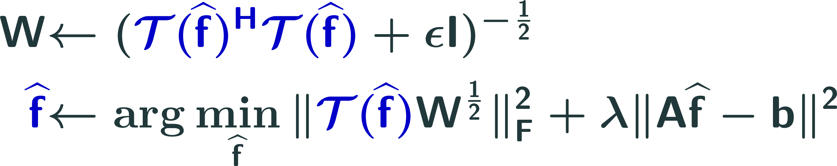
Original IRLS: To recover low-rank matrix X, iterate
We adapt to structured case:

Slide 28
Original IRLS: To recover low-rank matrix X, iterate
We adapt to structured case:
Without modification, this approach is still slow!

Slide 29
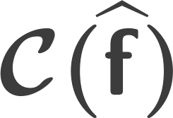
Idea 1: Embed Toeplitz lifting in circulant matrix
Toeplitz
Circulant
*Fast matrix-vector products with by FFTs

Slide 30
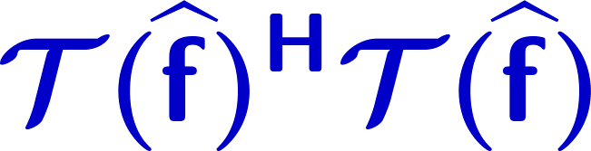
Idea 2: Approximate the matrix lifting
Pad with extra rows
*Fast computation of by FFTs

Slide 31


Simplifications: Weight matrix update
Explicit form:
Build Gram matrix with two FFTs—no matrix product
Computational cost: One eigen-decomposition of small Gram matrix
svd( )
eig( )

Slide 32



Simplifications: Least squares subproblem
Convolution with single filter
Sum-of-squares average:
Fast solution by CG iterations

Slide 33


Proposed GIRAF algorithm
GIRAF = Generic Iterative Reweighted Annihilating Filter
Adapt IRLS algorithm +simplifications based on structure
GIRAF algorithm
Update annihilating filter -Small eigen-decomposition
Least-squares annihilation
-Solve with CG

Slide 34


Slide 35



GIRAF complexity similar to iterative reweighted TV minimization
IRLS TV-minimization
GIRAF algorithm
Edge weights
Image
Edge weights
Image
Local update:
Least-squares
problem
Global update:
Least-squares
problem
w/small SVD

Slide 36



Convergence speed of GIRAF
Scaling with filter size
Table: iterations/CPU time to reach convergence tolerance of NMSE < 10⁻⁴.
CS-recovery from 50% random k-space samples
Image size: 256x256 Filter size: 15x15
(C-LORAKS spatial sparsity penalty)
CS-recovery from 50% random k-space samples
Image size: 256x256 (gradient sparsity penalty)

Slide 37
Outline
Prior Art
Proposed Algorithm
Applications

Slide 38

GIRAF enables larger filter sizes → improved compressed sensing recovery
+1 dB improvement

Slide 39


GIRAF enables extensions to multi-dimensional imaging: Dynamic MRI
Fully sampled
GIRAF
Fourier sparsity
TV
error images
[Balachandrasekaran, O., & Jacob, Submitted to ICIP 2016]

Slide 40

GIRAF enables extensions to multi-dimensional imaging: Diffusion Weighted Imaging
Correction of ghosting artifacts
In DWI using annihilating filter framework and GIRAF
[Mani et al., ISMRM 2016]

Slide 41

Summary
Emerging trend: Powerful Fourier domain low-rank penalties for MRI reconstruction
State-of-the-art, but computational challenging
Current algs. work directly with big “lifted” matrices
New GIRAF algorithm for structured low-rank matrix formulations in MRI
Solves “lifted” problem in “unlifted” domain
No need to create and store large matrices
Improves recovery & enables new applications
Larger filter sizes → improved CS recovery
Multi-dimensional imaging (DMRI, DWI, MRSI)

Slide 42
References
Krahmer, F., & Ward, R. (2014) Stable and robust sampling strategies for compressive imaging. Image Processing, IEEE Transactions on, 23(2): 612-622.
Pan, H., Blu, T., & Dragotti, P. L. (2014). Sampling curves with finite rate of innovation. Signal Processing, IEEE Transactions on, 62(2), 458-471.
Shin, P. J., Larson, P. E., Ohliger, M. A., Elad, M., Pauly, J. M., Vigneron, D. B., & Lustig, M. (2014). Calibrationless parallel imaging reconstruction based on structured low‐rank matrix completion. Magnetic resonance in medicine, 72(4), 959-970.
Haldar, J. P. (2014). Low-Rank Modeling of Local-Space Neighborhoods (LORAKS) for Constrained MRI. Medical Imaging, IEEE Transactions on, 33(3), 668-681
Jin, K. H., Lee, D., & Ye, J. C. (2015, April). A novel k-space annihilating filter method for unification between compressed sensing and parallel MRI. In Biomedical Imaging (ISBI), 2015 IEEE 12th International Symposium on (pp. 327-330). IEEE.
Ongie, G., & Jacob, M. (2015). Super-resolution MRI Using Finite Rate of Innovation Curves. Proceedings of ISBI 2015, New York, NY.
Ongie, G. & Jacob, M. (2015). Recovery of Piecewise Smooth Images from Few Fourier Samples. Proceedings of SampTA 2015, Washington D.C.
Ongie, G. & Jacob, M. (2015). Off-the-grid Recovery of Piecewise Constant Images from Few Fourier Samples. Arxiv.org preprint.
Fornasier, M., Rauhut, H., & Ward, R. (2011). Low-rank matrix recovery via iteratively reweighted least squares minimization. SIAM Journal on Optimization, 21(4), 1614-1640.
Mohan, K, and Maryam F. (2012). Iterative reweighted algorithms for matrix rank minimization." The Journal of Machine Learning Research 13.1 3441-3473.
Acknowledgements
Supported by grants: NSF CCF-0844812, NSF CCF-1116067, NIH 1R21HL109710-01A1, ACS RSG-11-267-01-CCE, and ONR-N000141310202.

Slide 43
Thank you! Questions?
GIRAF algorithm for structured low-rank matrix recovery formulations in MRI
Exploit convolution structure to simplify IRLS algorithm
Do not need to explicitly form large lifted matrix
Solves problem in original domain

